Slide 1
Introduction
Earlier chapters discussed direct methods for computing eigenvalues of real matrices. These methods require O(n³) flops and are not practical for large matrices.
Often only certain eigenvalues and associated eigenvectors are required, so what we really require is a means of computing the ones we need.

Slide 2
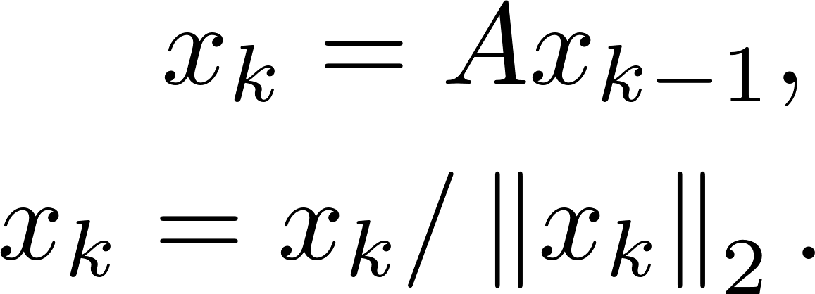
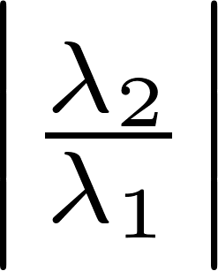
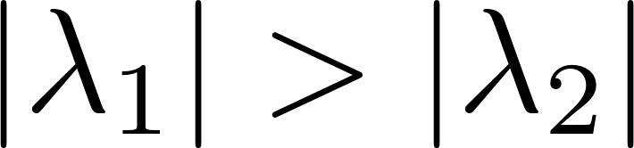
The Power Method
Recall that the power method requires a loop that executes
All that is required is matrix-vector multiplication and normalization. The initial guess should be randomly generated, and the convergence rate depends on the ratio , where are two largest eigenvalues in magnitude.

Slide 3
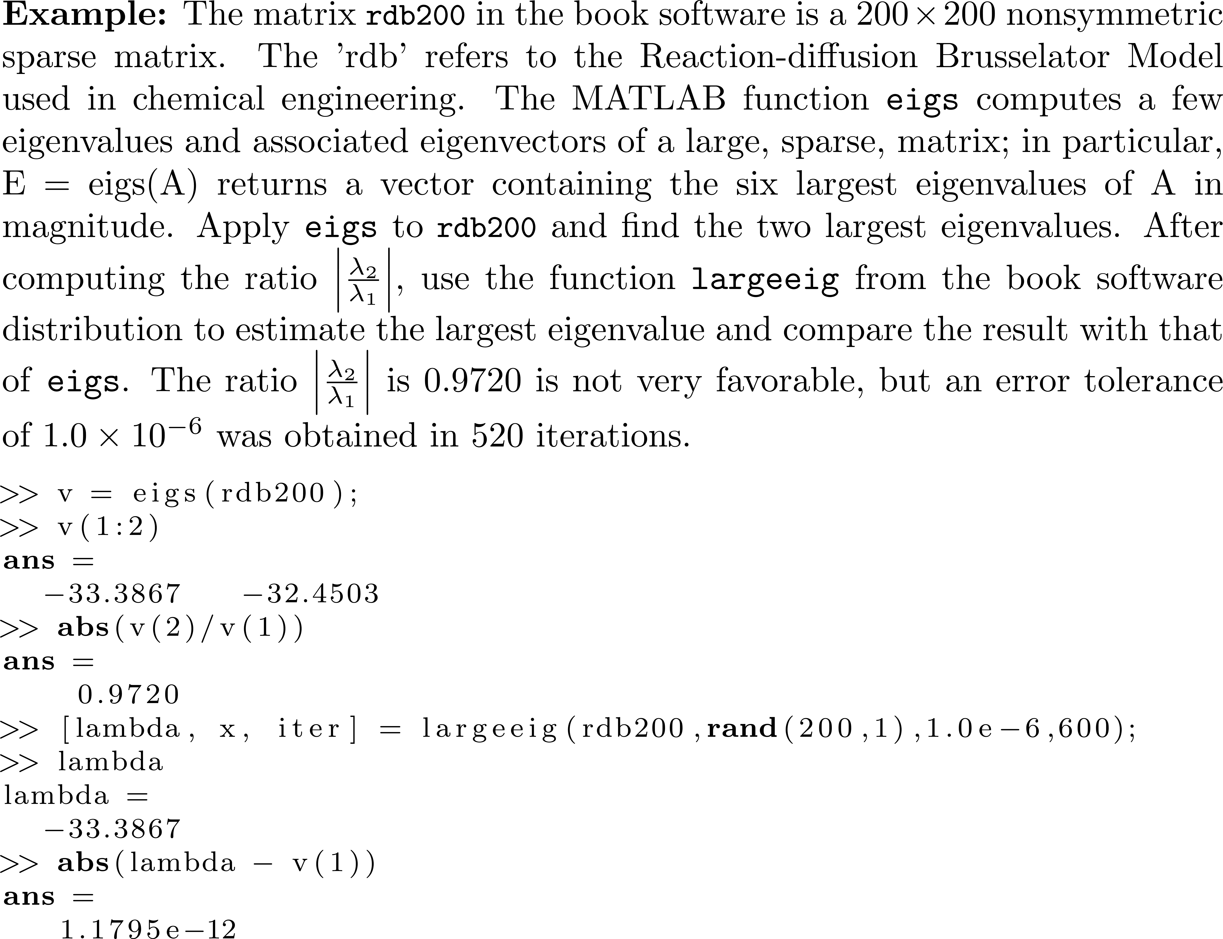
Example 1

Slide 4
Example 1
rdb200

Slide 5
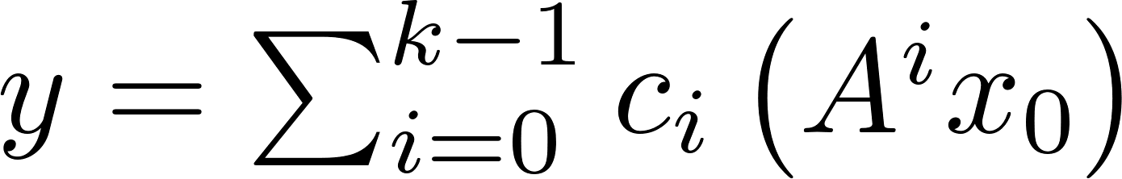
NOTE
Starting with x₀ , the power method generates the Krylov subspace Of these vectors, only A_{k-1} x₀ is used as the approximate eigenvector. It seems reasonable that we can do better by choosing the approximate eigenvector as a linear combination of vectors from the Krylov subspace.

Slide 6
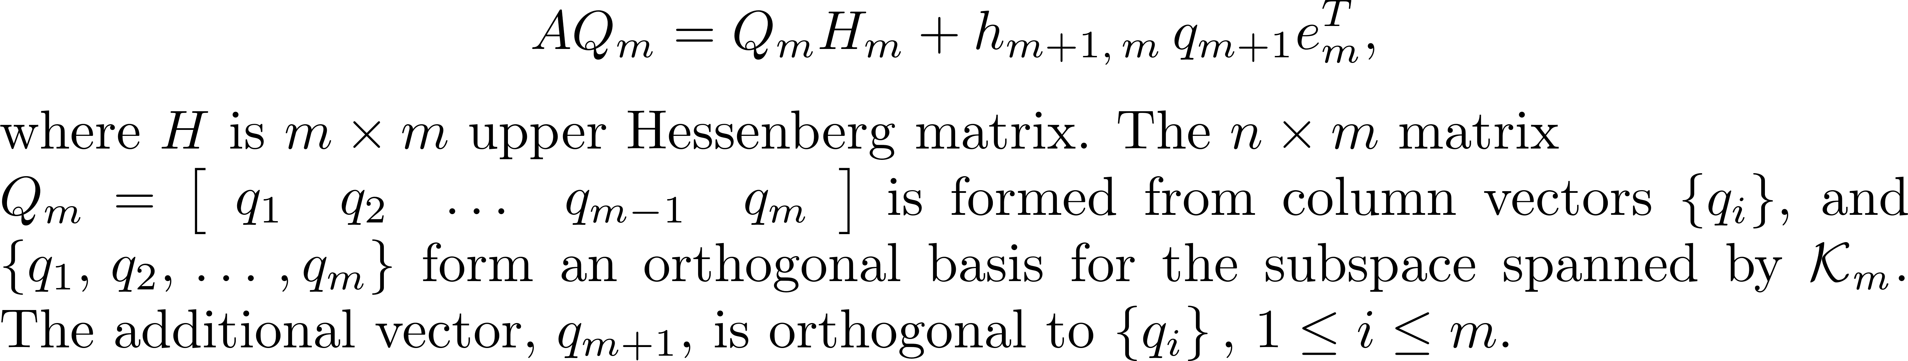
Eigenvalue Computation using the Arnoldi Process
Arnoldi process
Can we use the eigenvalues of H_{m} to approximate the eigenvalues of A?
Only a few of those m eigenvalues will lead to good approximations to the eigenvalues of A, and those eigenvalues tend to be the largest and the smallest eigenvalues of H_{m} .

Slide 7
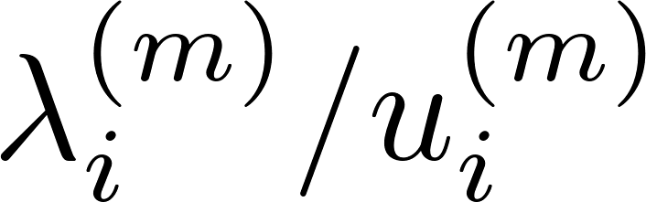
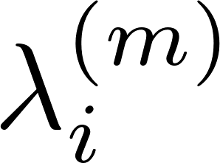
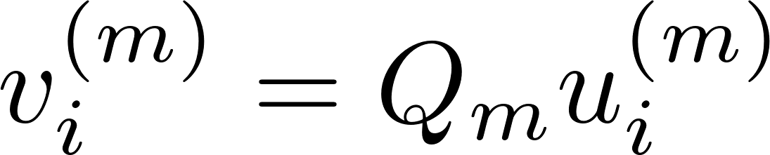
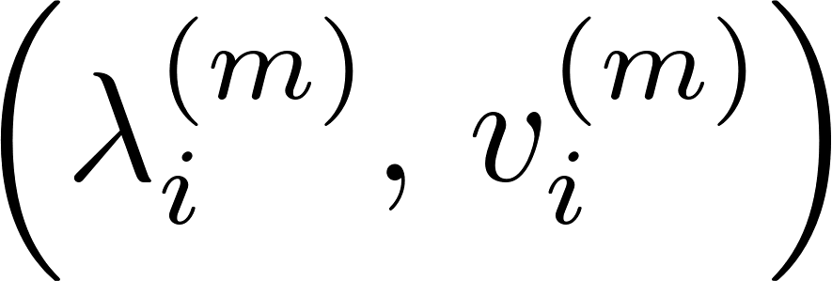
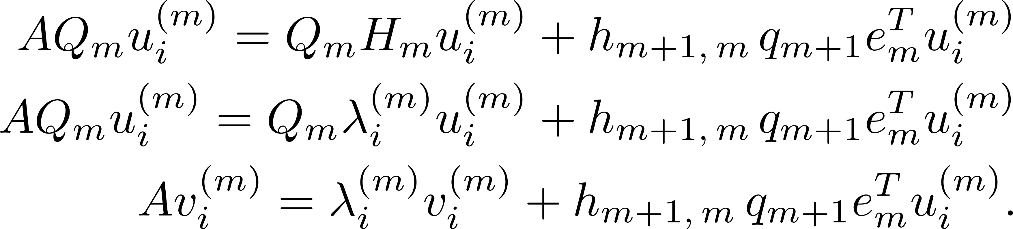
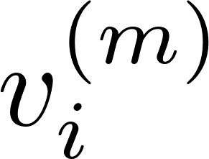
Ritz Values
If is an eigenvalue and associated eigenvector of H_{m}, is a Ritz value, is a Ritz eigenvector, and is a Ritz pair. Then,
Reason for calling a Ritz eigenvector.

Slide 8
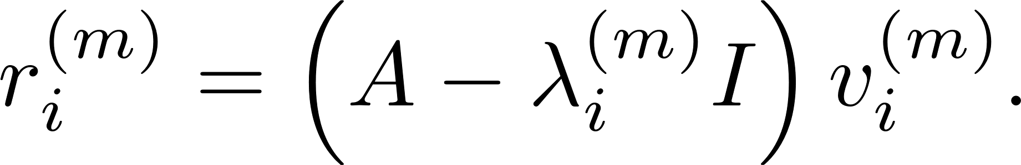
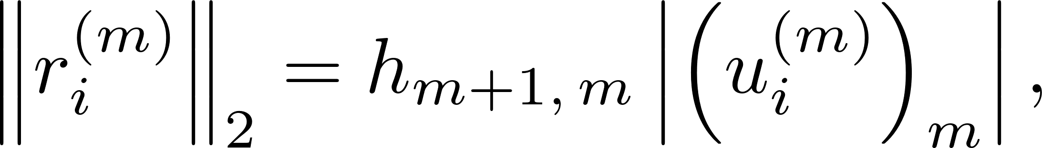
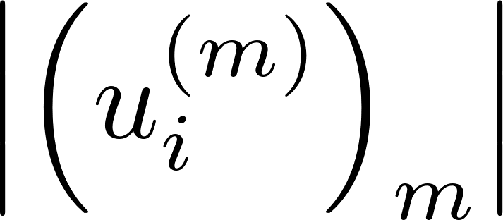
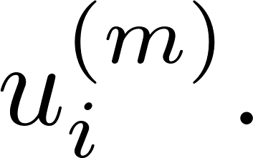
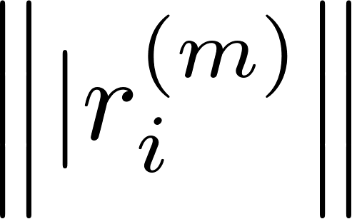
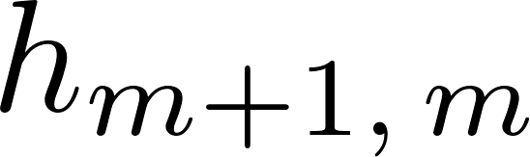
Ritz Values
Define Since there results where is component m of If or is small, is an estimate of the error in using as an eigenpair of A.

Slide 9
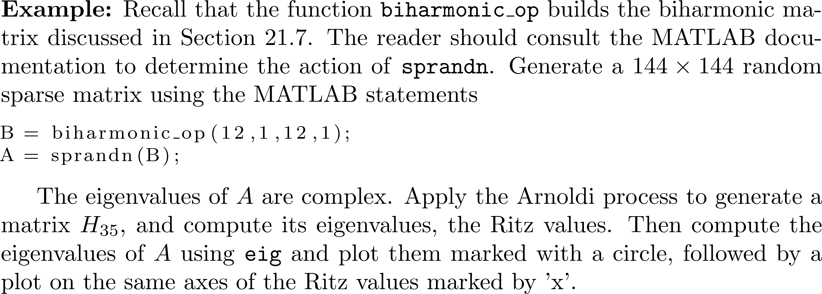
Eigenvalues of H_{m} Near the Ends of the Spectrum
The largest and smallest Ritz values in magnitude tend to be closest to eigenvalues of A.

Slide 10
Eigenvalues of H_{m} Near the Ends of the Spectrum

Slide 11
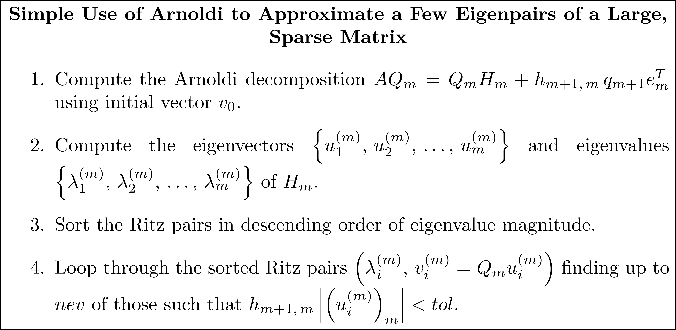
Estimating Eigenvalues without Restart or Deflation

Slide 12
Estimating Eigenvalues using Explicit Restart
With the GMRES and MINRES methods for solving sparse systems of equations, it is normally necessary to restart the Arnoldi or Lanczos process using the most recently estimated solution as the initial vector.
Assume nev eigenvalues are required. If k<nev of the current Ritz pairs are sufficiently accurate, we can retain those and then restart Arnoldi with an improved initial vector in hopes of estimating the remaining eigenvalues.

Slide 13
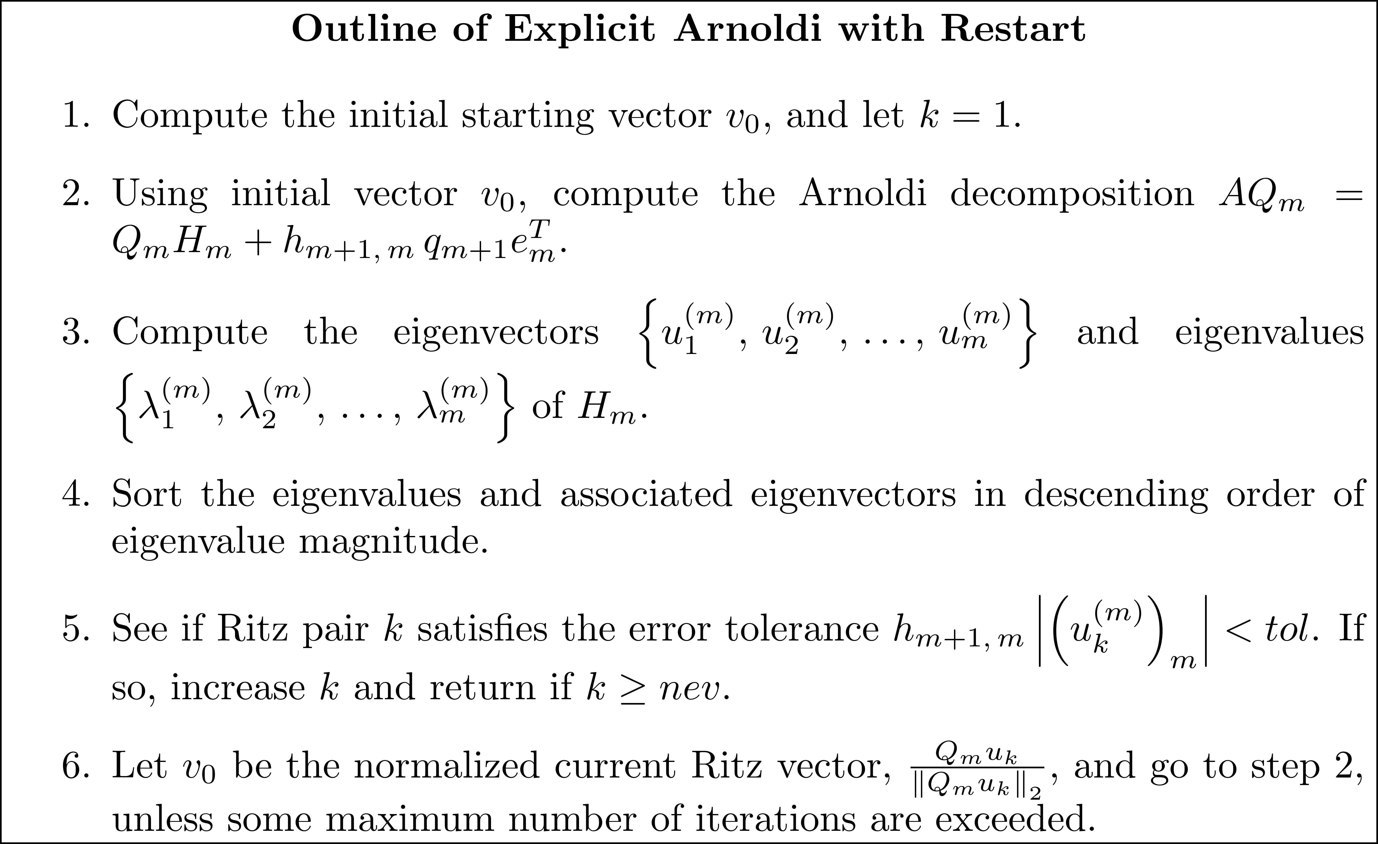
Estimating Eigenvalues using Explicit Restart

Slide 14
A Restart Method using Deflation
Recall that the approach to the eigenvalue problem for a dense matrix was to compute one eigenvalue at a time using deflation. After computing eigenvalue λ_{k} , “deflate” the problem to computing an eigenvalue in the (k-1) × (k-1) submatrix.
Deflation is a component of production quality algorithms for computing a few eigenpairs of a sparse matrix.

Slide 15
A Restart Method using Deflation
Assume that we want a few of the largest eigenvalues in magnitude and that those eigenvalues are real. The idea is to find the eigenvalues in descending order of magnitude so that the eigenvalues are on an nev x nev upper triangular submatrix of H_{m}. The next page shows H_{m} as the first nev eigenvalues are computed.

Slide 16
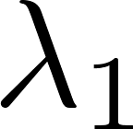
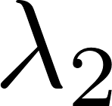
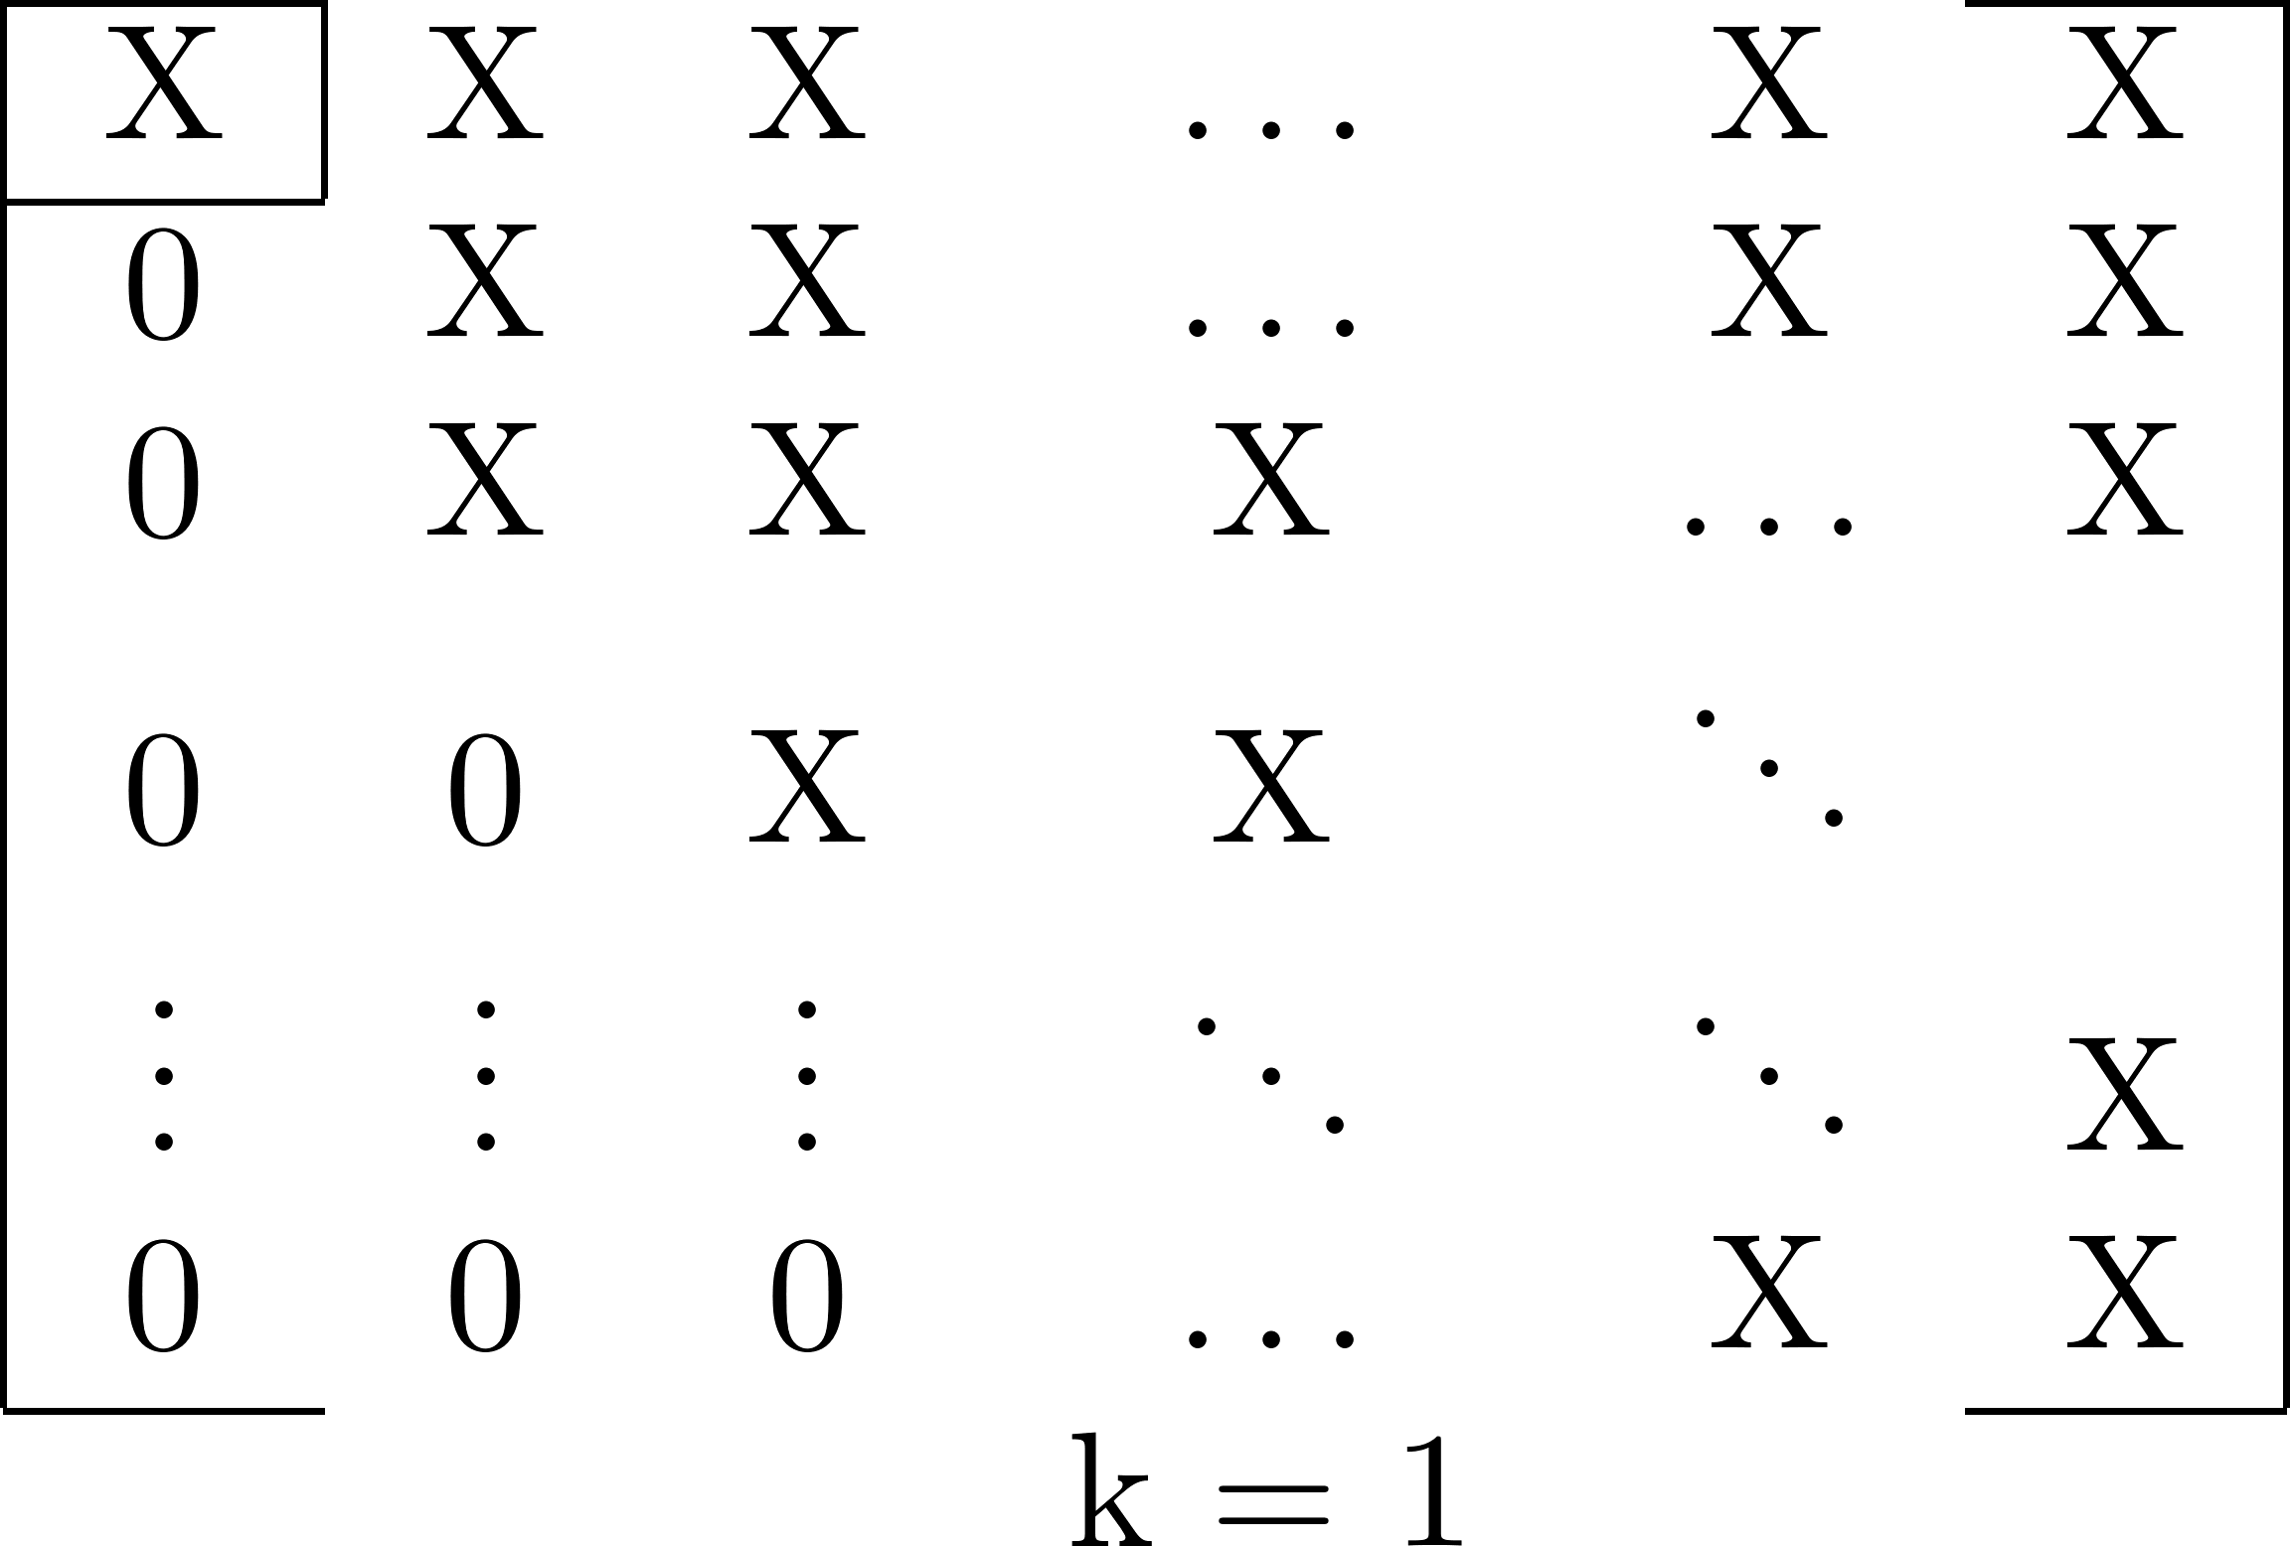
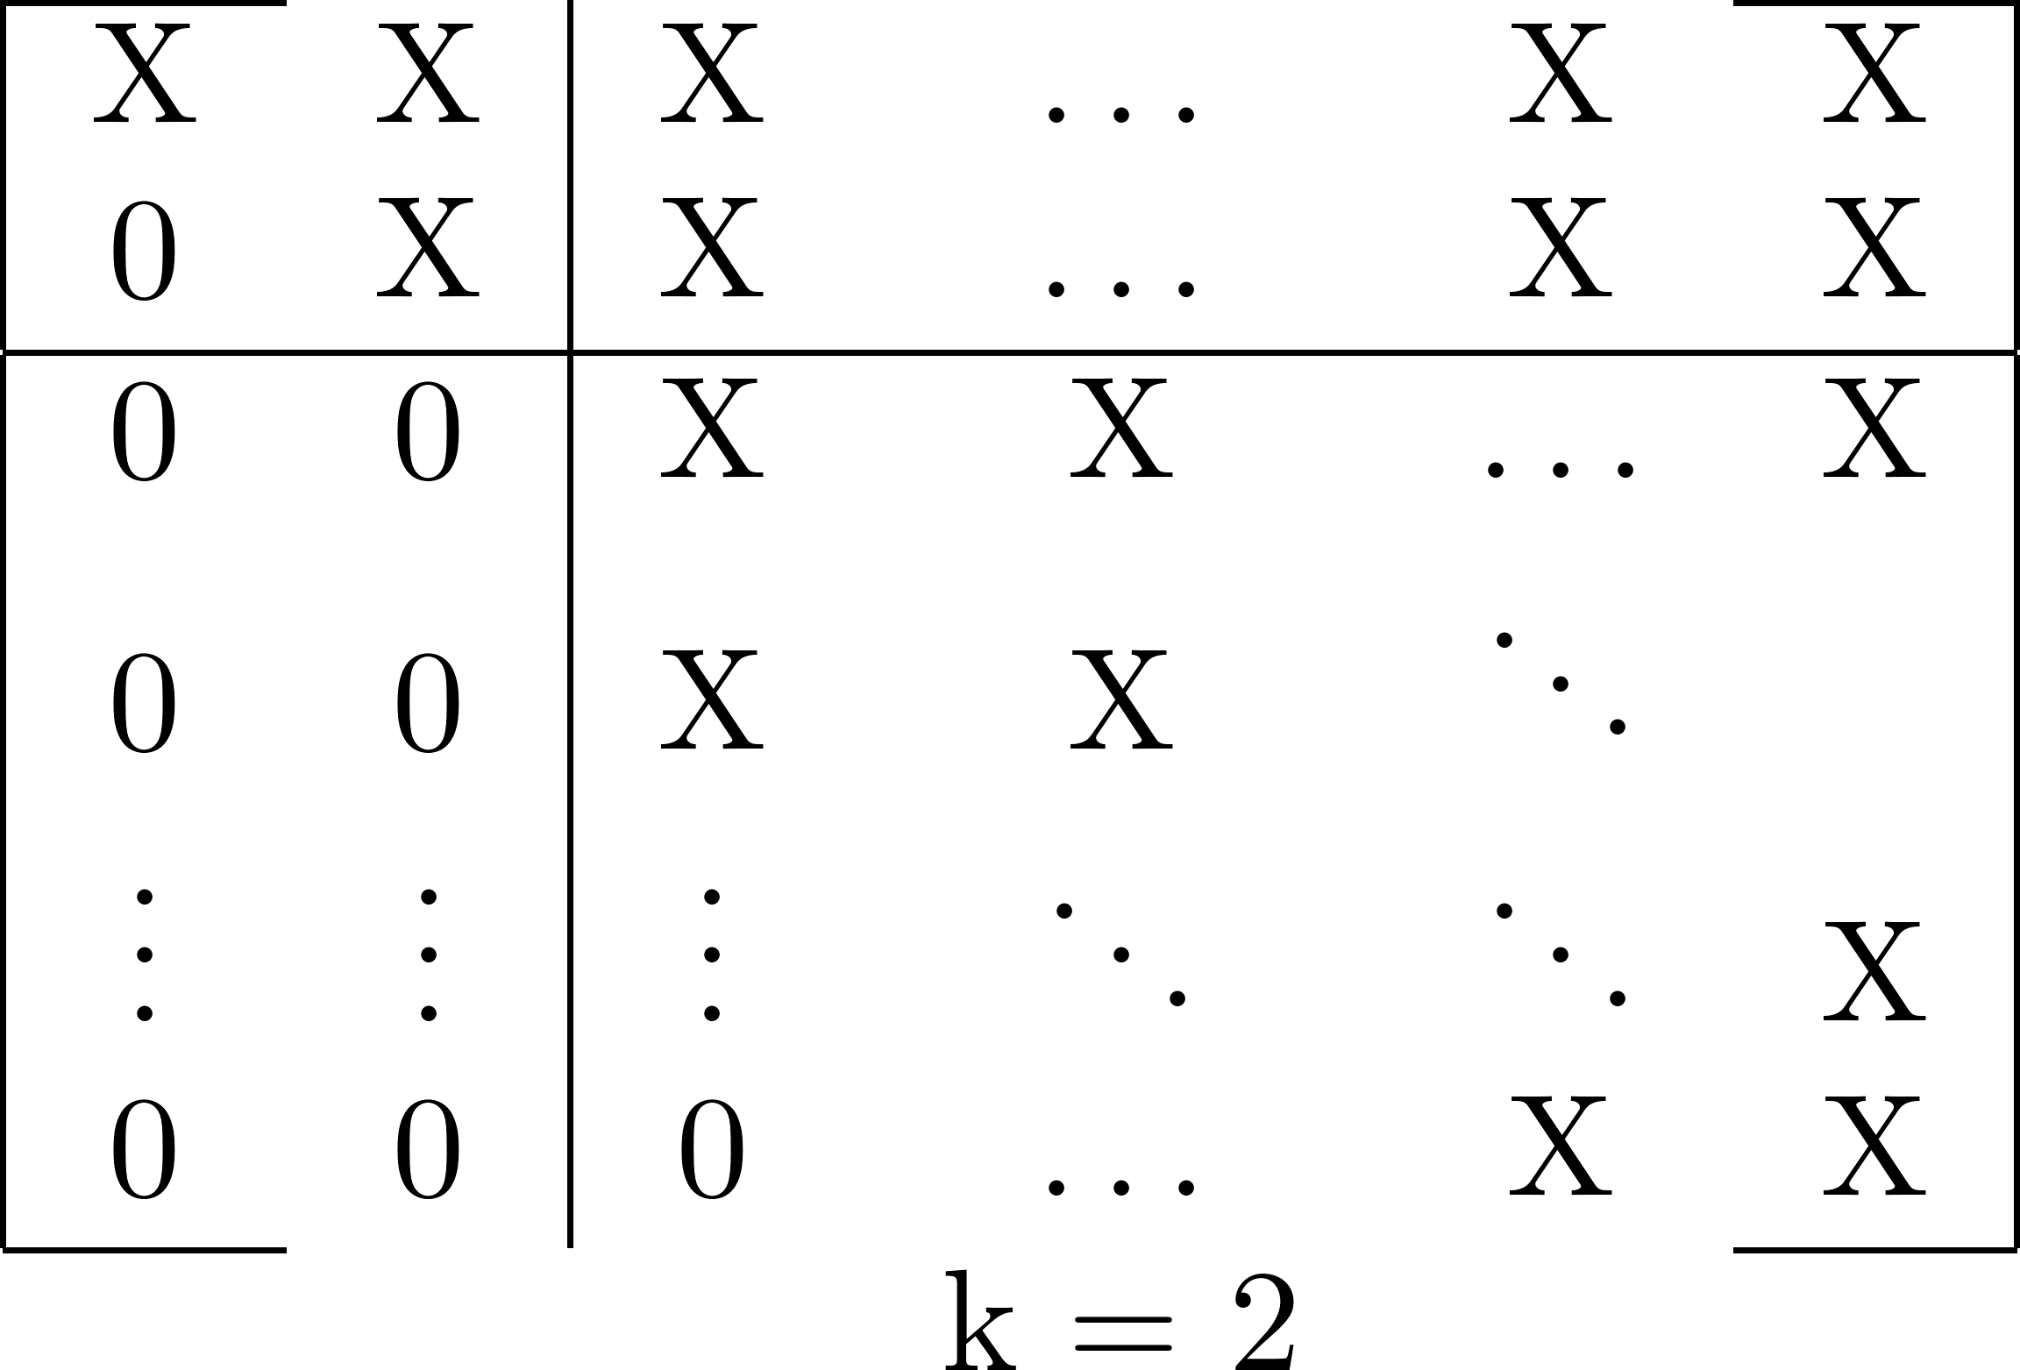
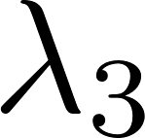
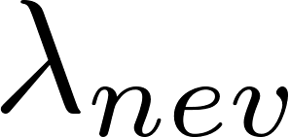
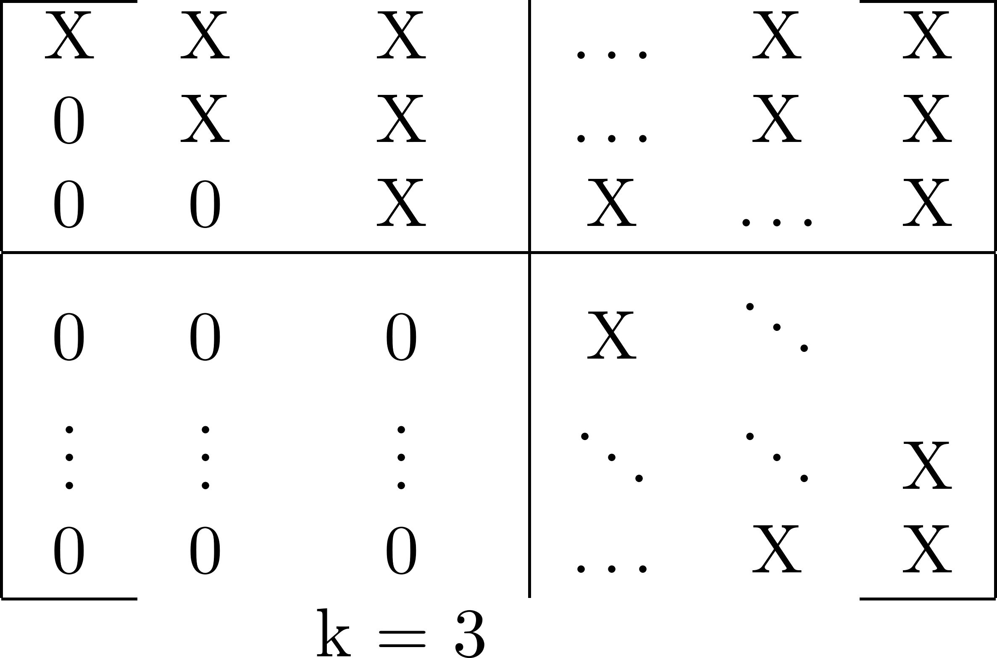
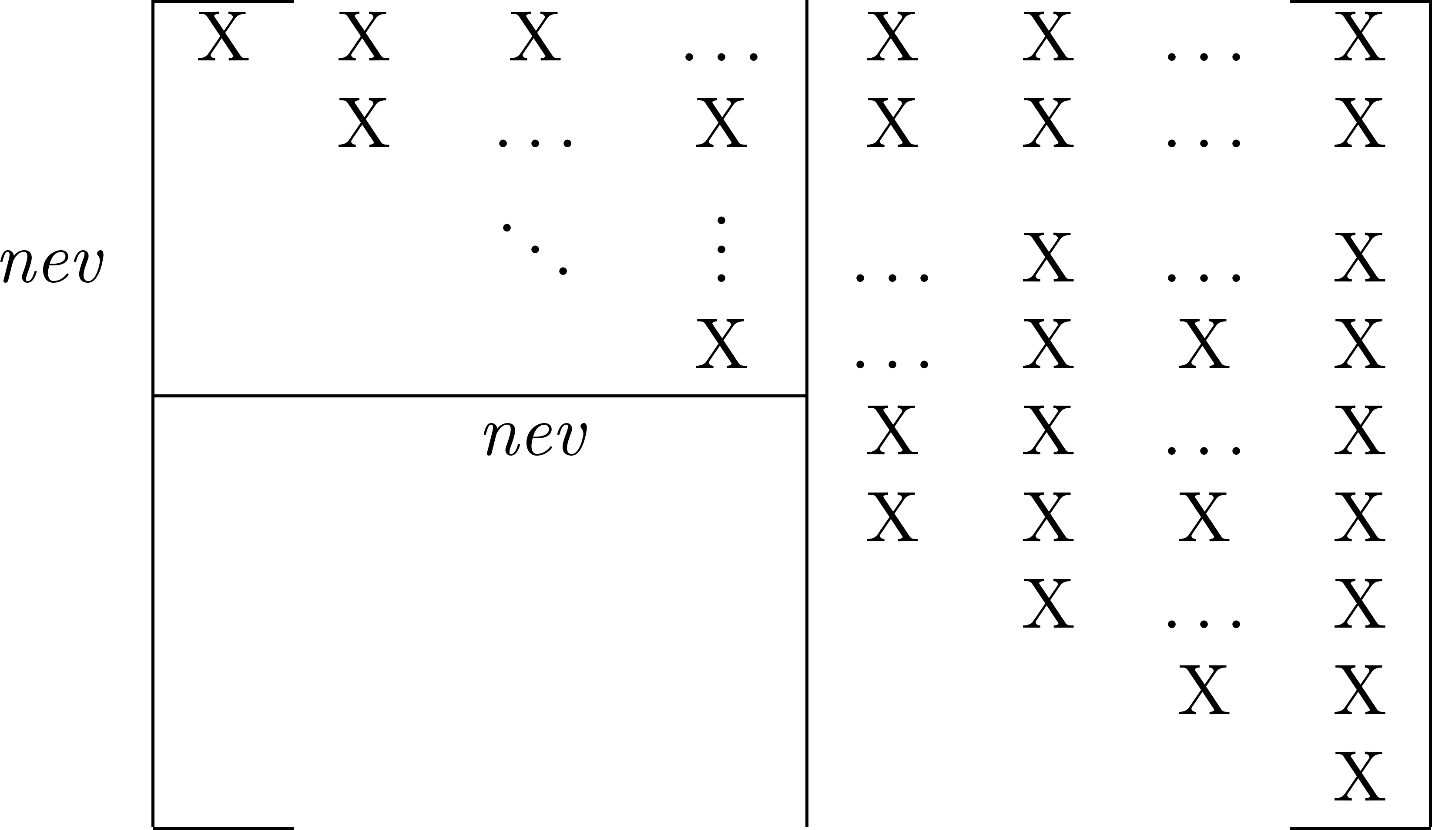
A Restart Method using Deflation
Eigenvalue .
Column 1 locked.
Eigenvalues , .
Column 2 locked.
Eigenvalues , , .
Column 3 locked.
Eigenvalues , , ... , .
Column nev locked.

Slide 17
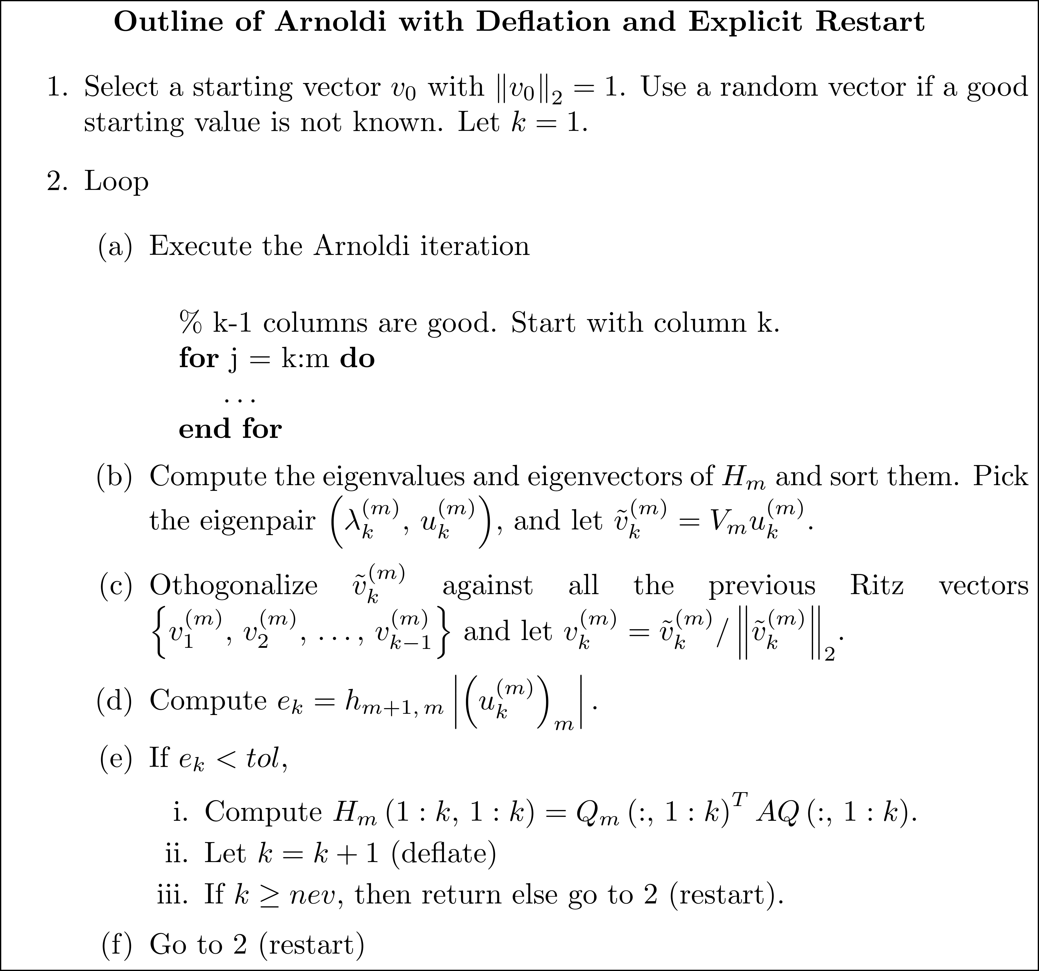
A Restart Method using Deflation

Slide 18
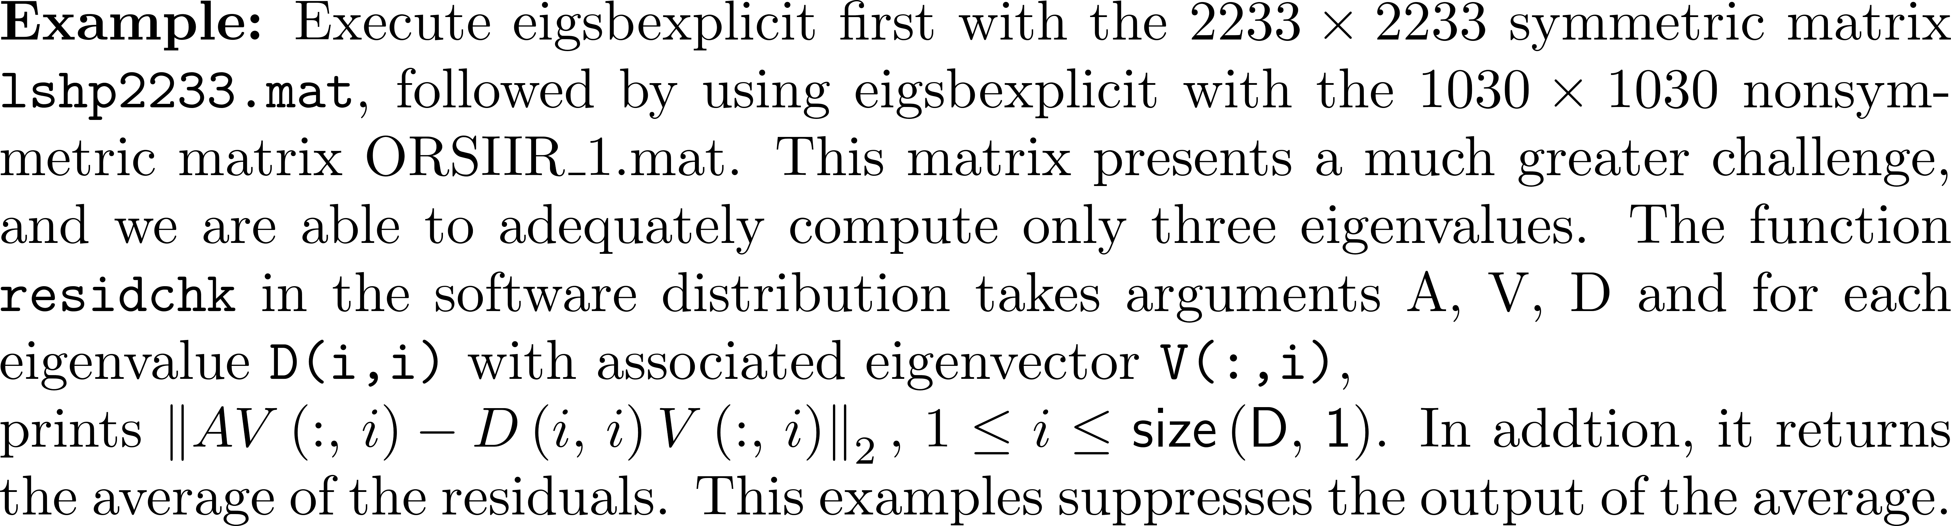
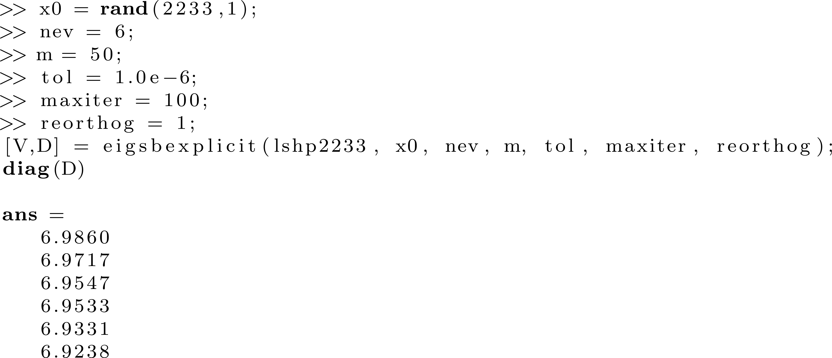
Example 2

Slide 19
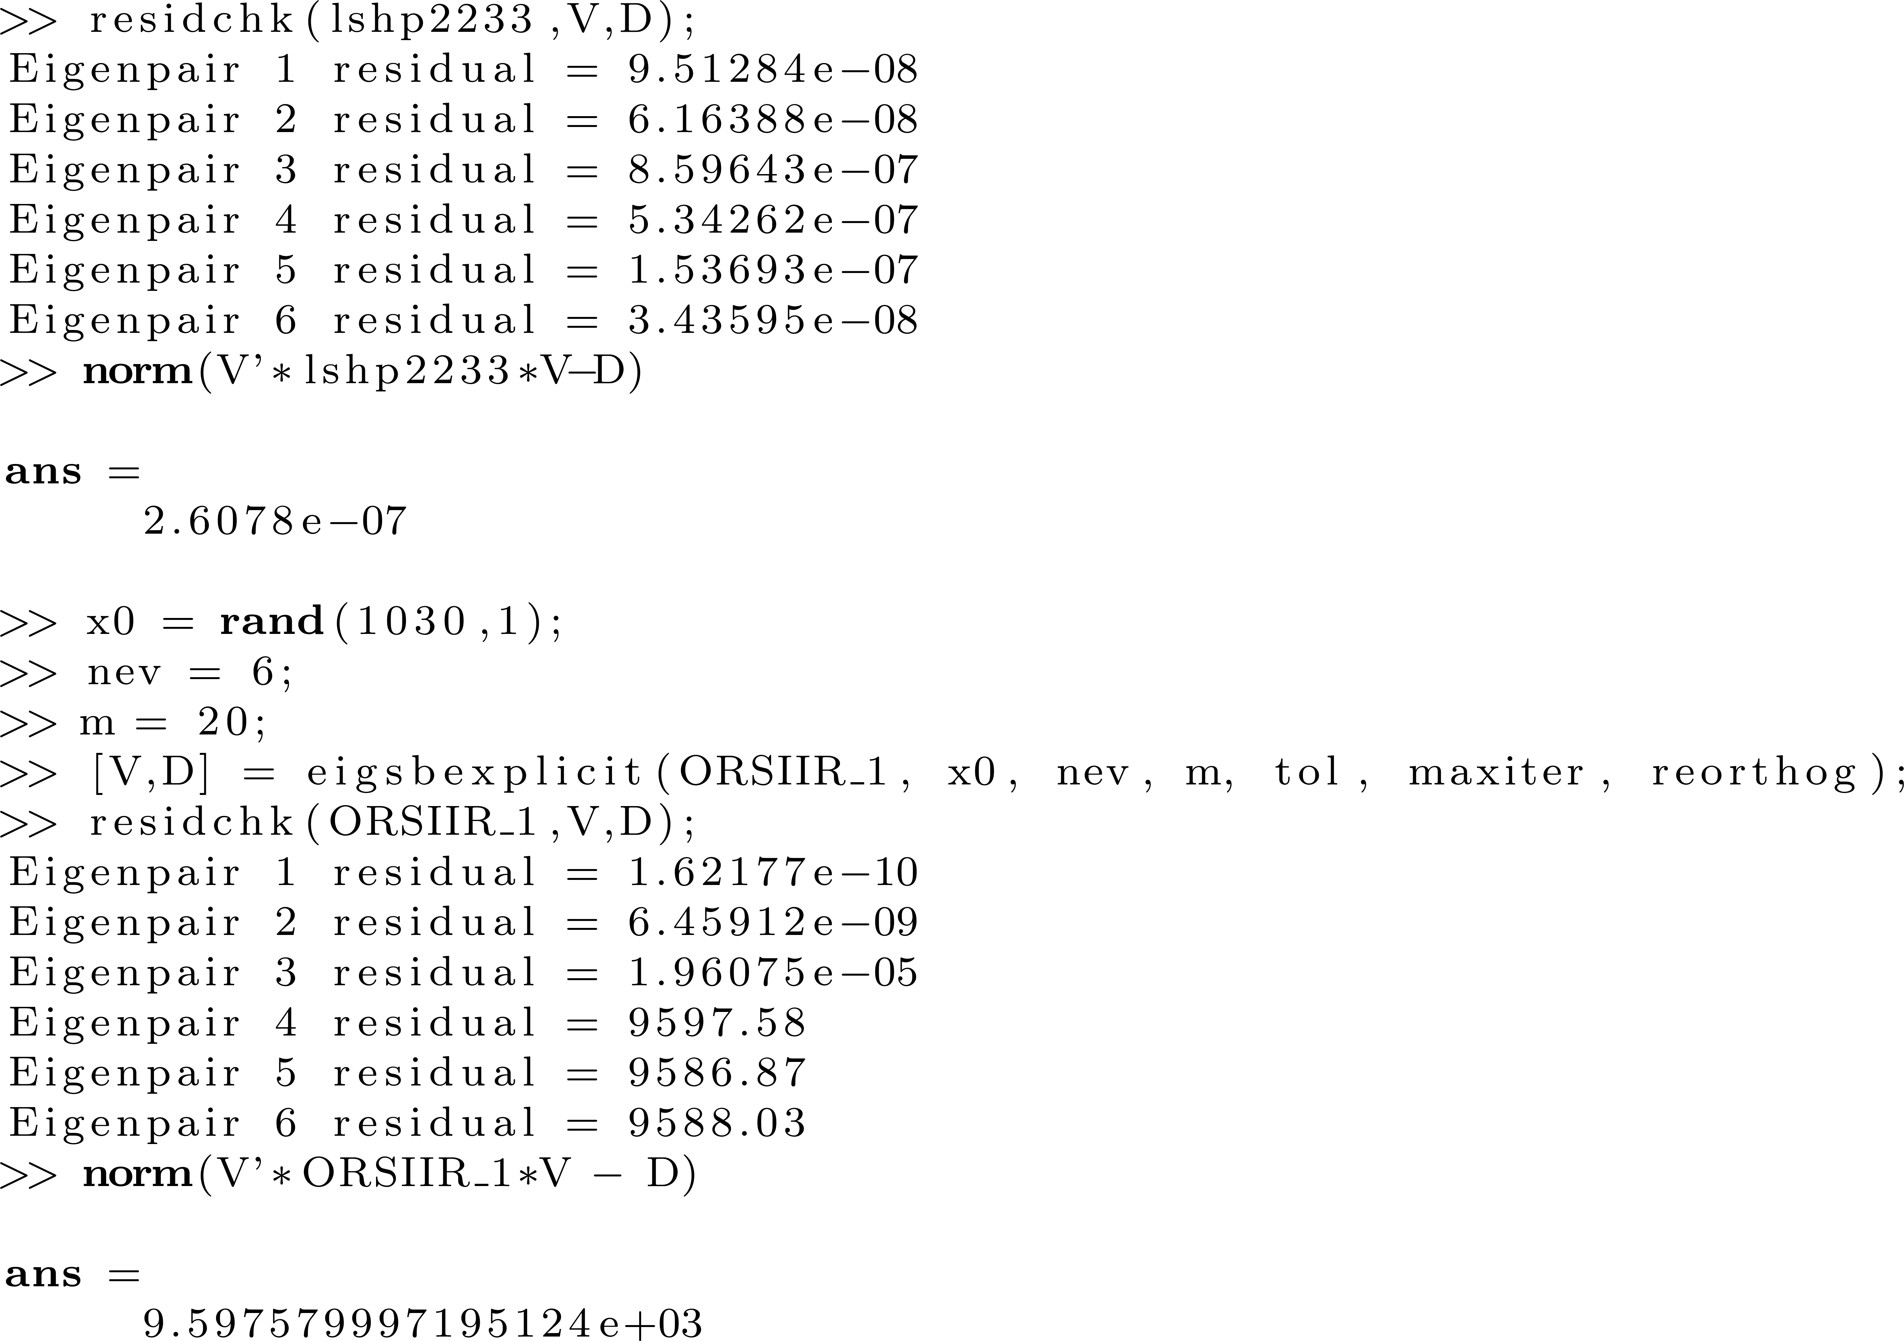
Example 2

Slide 20
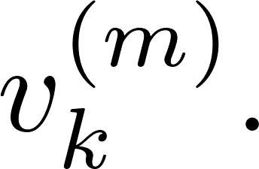
Restart Strategies
So far, have restarted with the current Ritz eigenvector
Best strategy is to select a vector v such that H_{m}( i+1,i )=0 so that Q(:,1:i ) is in an invariant subspace of dimension i . The Arnoldi iteration stops at iteration i, and the i eigenvalues are exact.
Reasonable strategy is to select a vector close to being in an invariant subspace of dimension less than or equal to m.

Slide 21
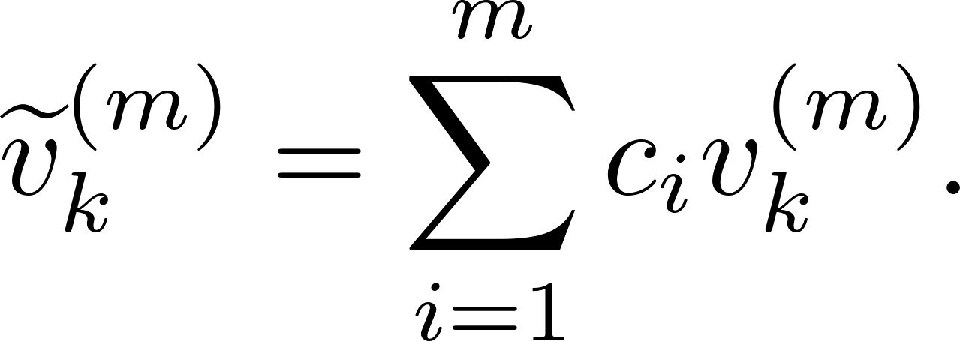
Restart Strategies
Can choose to restart with a vector that is a linear combination of the current Ritz vectors,
A more sophisticated approach involves constructing a polynomial which, when applied to A , can improve the current Ritz vector prior to restarting Arnoldi.

Slide 22
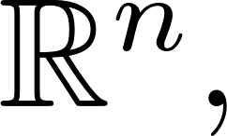
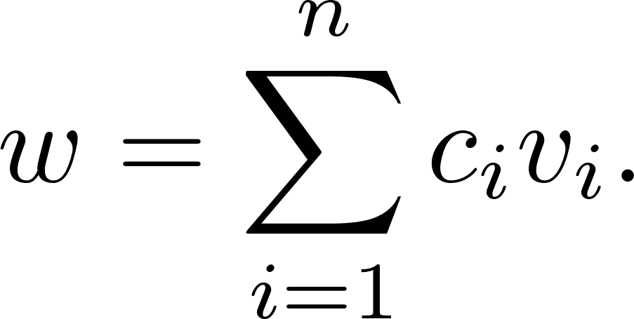
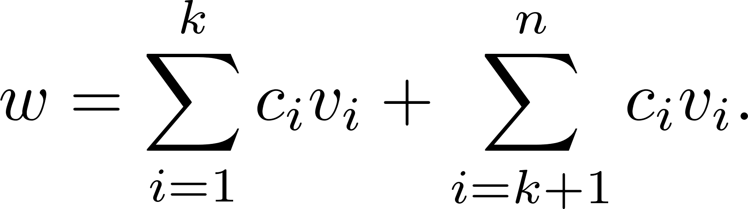
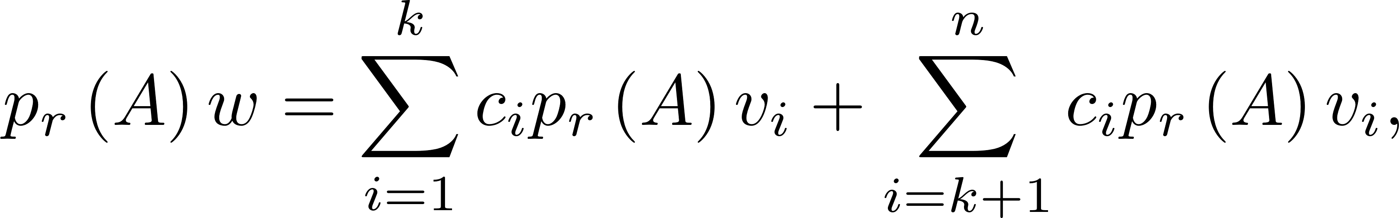
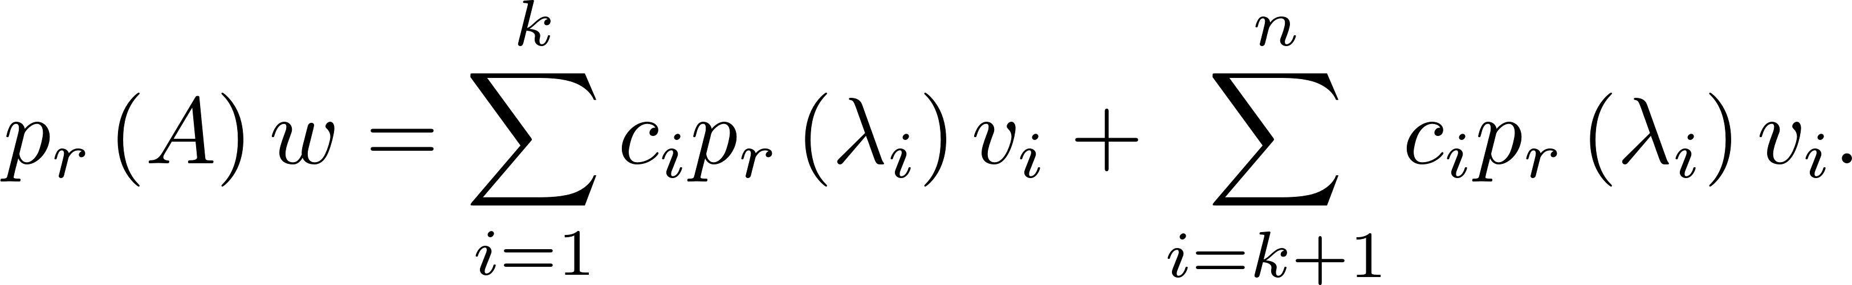
Restart Strategies
Assume that v₁, v₂, ..., v_{n} are a basis for and that w is a vector We are interested in approximating k of these eigenvectors, so write the sum as
Let p_{r} be a polynomial, compute p_{r}(A) , apply it to w and obtain so

Slide 23
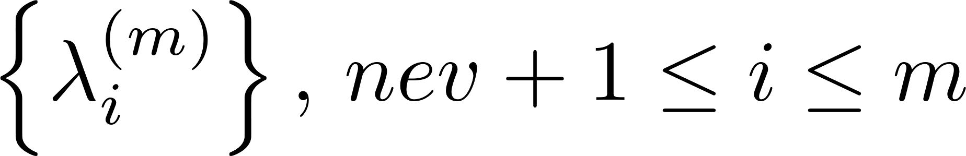
Restart Strategies
Build p_{r} so that p_{r}( λ_{i} ), k+1 ≤ i ≤ n , are small relative to p_{r}( λ_{i} ),1 ≤ i ≤ k . Then p_{r}(A)w will be dominated by the eigenvalues in which we are interested.
p_{r} is called a filtering polynomial.
Consider the filtering polynomial where are the Ritz values we do not want.
Costly to compute.

Slide 24
Restart Strategies
p_{r}(A) an be evaluated quickly by using the implicit QR iteration, and this is the basis for the implicitly restarted Arnoldi method, the method of choice for the problem.

Slide 25
The Implicitly Restarted Arnoldi Method
The MATLAB function eigs uses a version of this algorithm.
A filter polynomial enhances convergence, and by using the Francis algorithm (implicitly shifted QR), the filtering polynomial can be evaluated in only O(m²) flops.

Slide 26
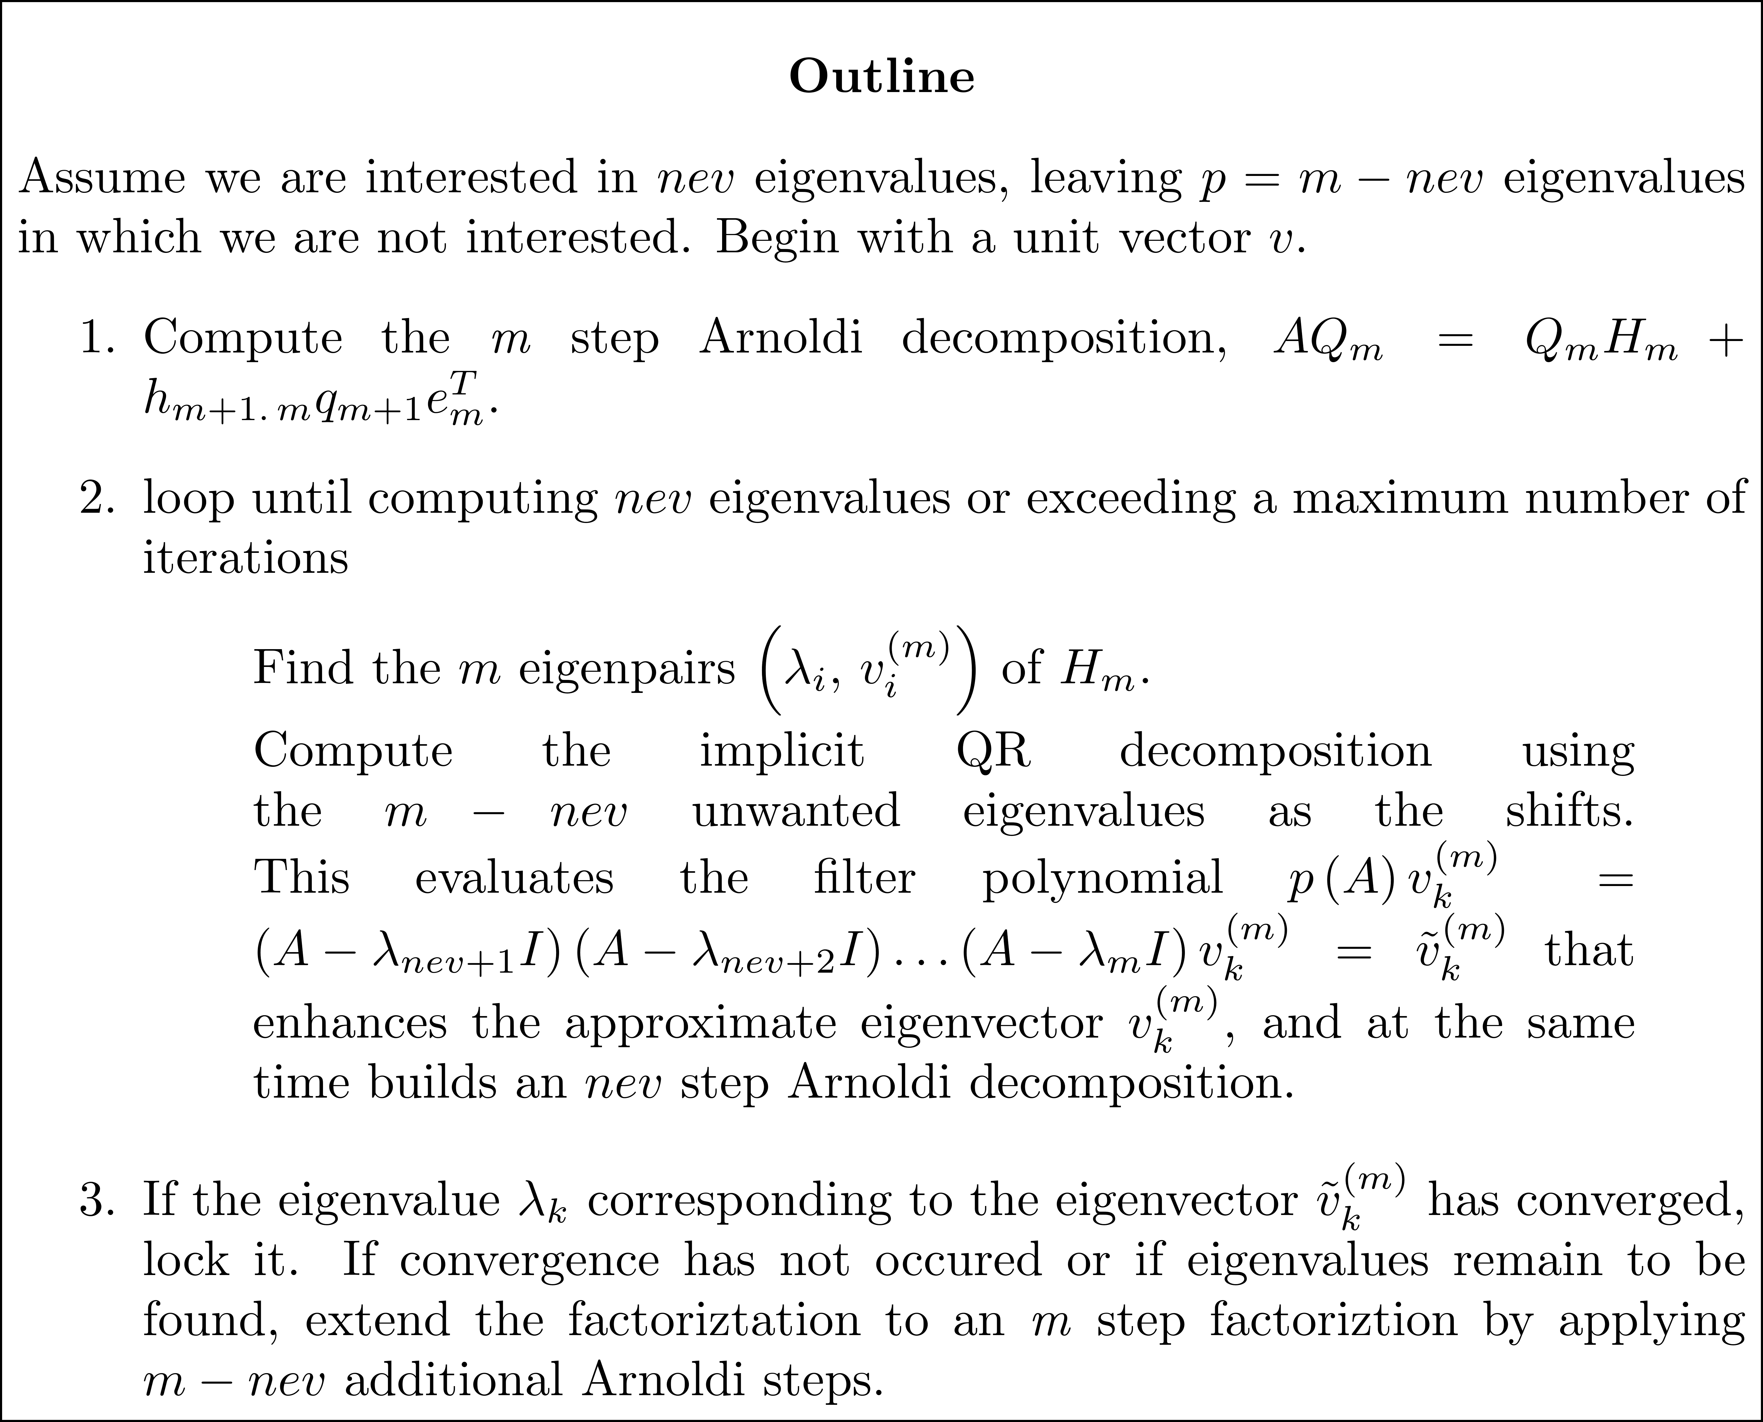
The Implicitly Restarted Arnoldi Method

Slide 27
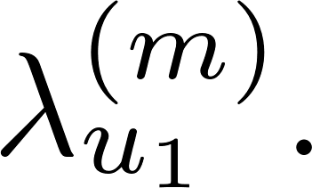
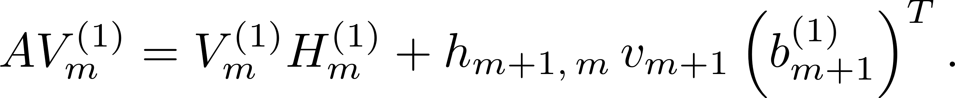
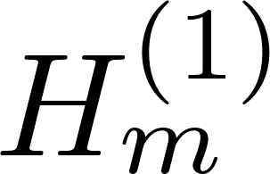
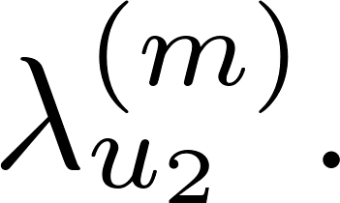
The Implicitly Restarted Arnoldi Method
Assume m-nev = 2. Compute the implicit QR decomposition of H_{m} with shift This results in an Arnoldi decomposition
Follow this by computing the implicit QR decomposition of with shift

Slide 28
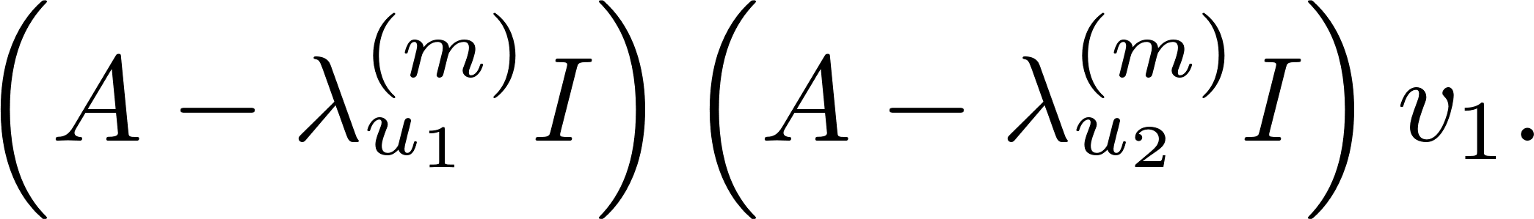
The Implicitly Restarted Arnoldi Method
This results in a decomposition that is exactly the one that would be obtained by executing (m-2) steps of the Arnoldi process to the unit vector obtained from
Either accept an eigenvalue or perform two more Arnoldi steps to obtain an m step Arnoldi decomposition.

Slide 29
Algorithm eigsb
The algorithm eigsb is supported by the function arnoldif that computes the Arnoldi decomposition in the form

Slide 30
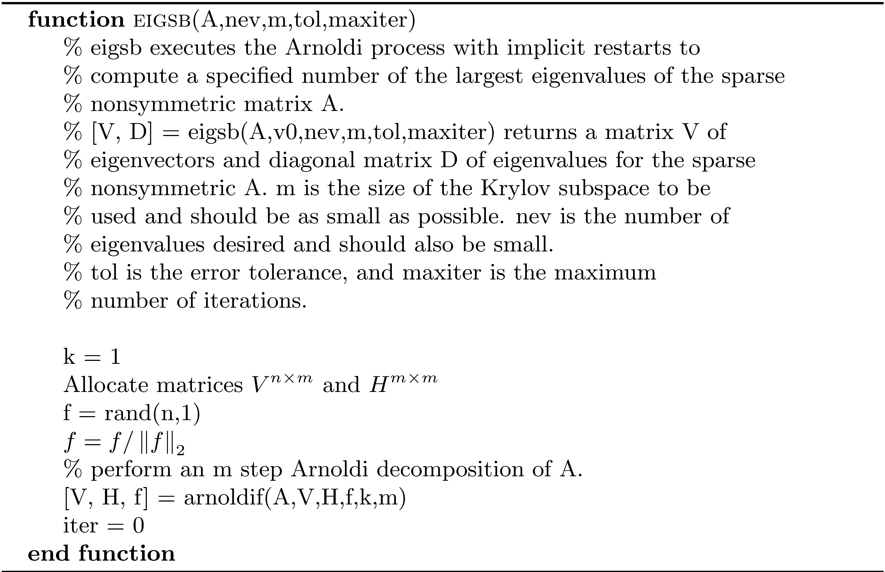
Algorithm eigsb

Slide 31
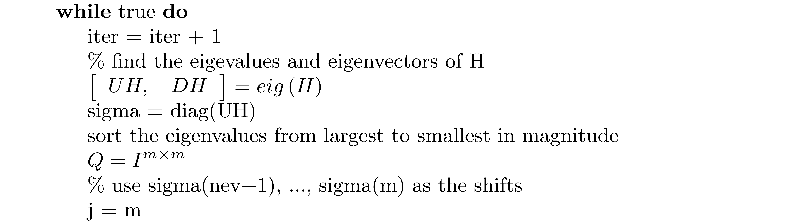
Algorithm eigsb

Slide 32
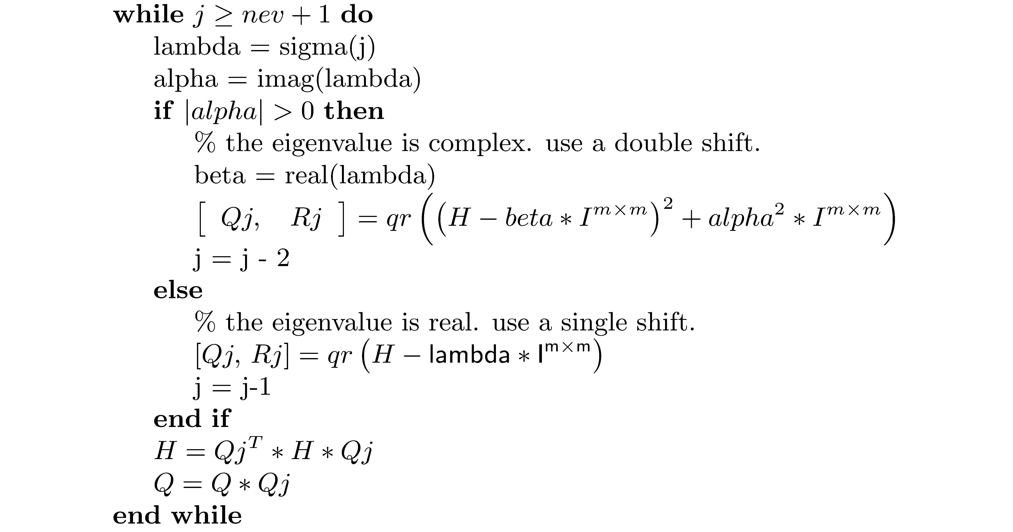
Algorithm eigsb

Slide 33

Algorithm eigsb

Slide 34

Algorithm eigsb

Slide 35

Example 3

Slide 36
Eigenvalue Computation using the Lanczos Process
A sparse symmetric matrix A has properties that will enable us to compute eigenvalues and eigenvectors more efficiently than we are able to do for a nonsymmetric sparse matrix. Also, much more is known about convergence properties for the eigenvalue computations.
For instance, the following lemma is used to investigate approximate eigenpairs of A.

Slide 37

Eigenvalue Computation using the Lanczos Process
Recall that the Lanczos process for a symmetric matrix is the Arnoldi process for a symmetric matrix and takes the form

Slide 38



Eigenvalue Computation using the Lanczos Process
If is a Ritz value of T_{m}, using the lemma it follows that If is small, is a good approximation to

Slide 39
Eigenvalue Computation using the Lanczos Process
Poor convergence can result from a bad choice of the starting vector, so a random vector is a good choice.
Multiple eigenvalues or eigenvalues that are very close to each other particularly cause problems.
Roundoff error can cause lack or orthogonality among the Lanczos vectors, and this happens as soon as Ritz vectors have converged accurately enough to eigenvectors.

Slide 40
Eigenvalue Computation using the Lanczos Process
The loss of orthogonality can cause simple eigenvalues to appear as multiple eigenvalues, and these are called ghost eigenvalues.

Slide 41
Eigenvalue Computation using the Lanczos Process
The function eigssymb in the software distribution implements the implicitly restarted Lanczos process. The only real differences between this function and eigsb is the use of the Lanczos decomposition instead of Arnoldi and the fact that only a single shift is necessary since the matrix has real eigenvalues.

Slide 42

Example 4

Slide 43
Accuracy of the Lanczos Process
Error bounds indicate that for many matrices and for relatively small m , several of the largest or smallest of the eigenvalues of A are well approximated by eigenvalues of the corresponding Lanczos matrices. In practice it is not always the case that both ends of the spectrum of a symmetric matrix are approximated accurately. However, it is generally true that at least one end of the spectrum is approximated well.

